Slide 1
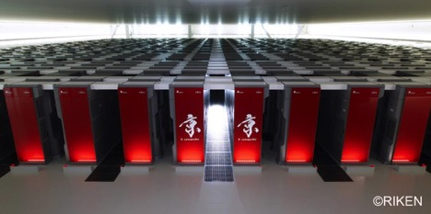
RIKEN Advanced Institute for Computational Science
K computer
Computation node specs | CPU | SPARC64™ VIIIfx 2GHz
 | Performance | 128 GF (16 GF x 8 cores)
 | Memory | 16 GB
Number of racks |  | 864
Number of nodes |  | 82,944
Network |  | Tofu Interconnect (6D Mesh/Torus)
Peak performance |  | 10.62 PF
Total memory capacity |  | 1.26 PB
File system |  | Fujitsu Exabyte File System (FEFS)
Storage |  | 30 PB
Top500 | No.1 for 2 consecutive times since Jun. 2011
Graph500 | No.1 in June 2014 & for 6 consecutive times since Jul. 2015
HPCG | No.2 for 4 consecutive times since Nov. 2014 No.1 for 3 consecutive times since Nov. 2016
The K computer strikes a balance between performance in calculation, memory, and communication

